Slide 1
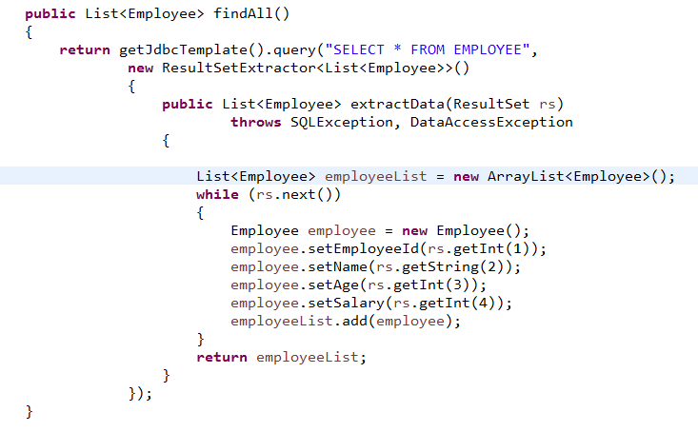
Querying for Multiple Rows

